Slide 1

R for Bioinformatics The Tidyverse
Maria-Theodora Pandi
PhD Candidate, Erasmus MC Rotterdam

Slide 2



about::me
PhD Candidate in Bioinformatics, Department of Pathology, Erasmus Medical Center
MSc in Informatics for Life Sciences, Bioinformatics Discipline, UoP
Pharmacy Bachelor Degree, UoP
@mtpandi17
@mtpandi
(Pharmaco)genomics, Bioinformatics, Machine Learning, Health Economics, Text Mining, Biostatistics, Visualization
R / Python

Slide 3
Table of contents
Tidyverse
dplyr
Pipes
Ggplot2
Structure of ggplot2
Aesthetics
Geometric elements
Choosing a plot
Layers
Scales
Colour
Facetting
facet_grid
facet_wrap
Coordinates, themes and saving the plots
Resources used

Slide 4


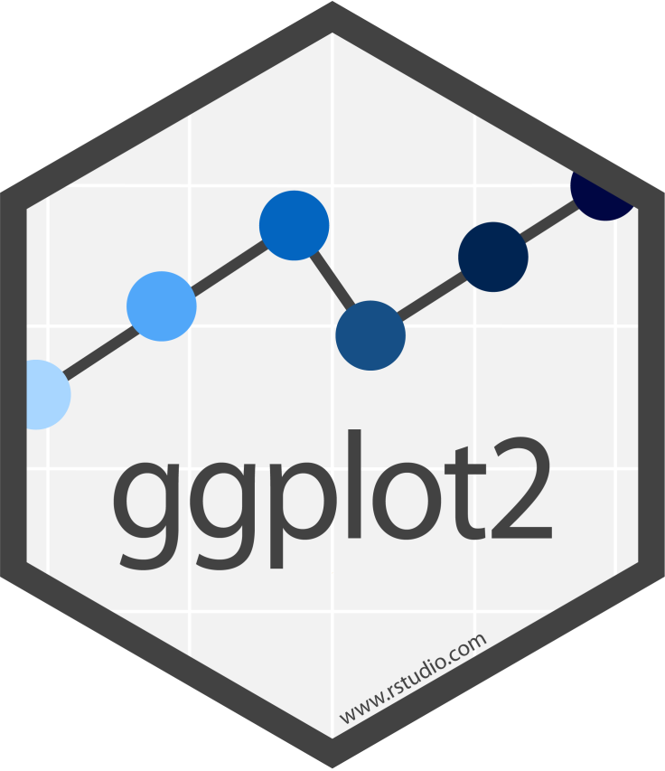

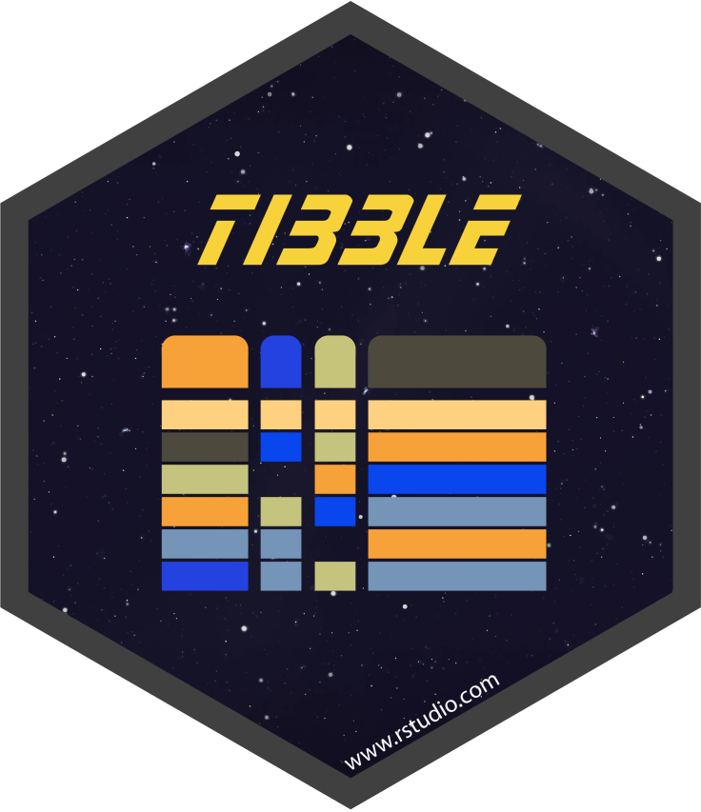



Tidyverse
A universe of tidy data
A collection of packages designed and created for data science, all sharing common philosophy, grammar and data structures
You can install all the packages:
install.packages("tidyverse")

Slide 5
Part IIIa
Data handling with dplyr

Slide 6
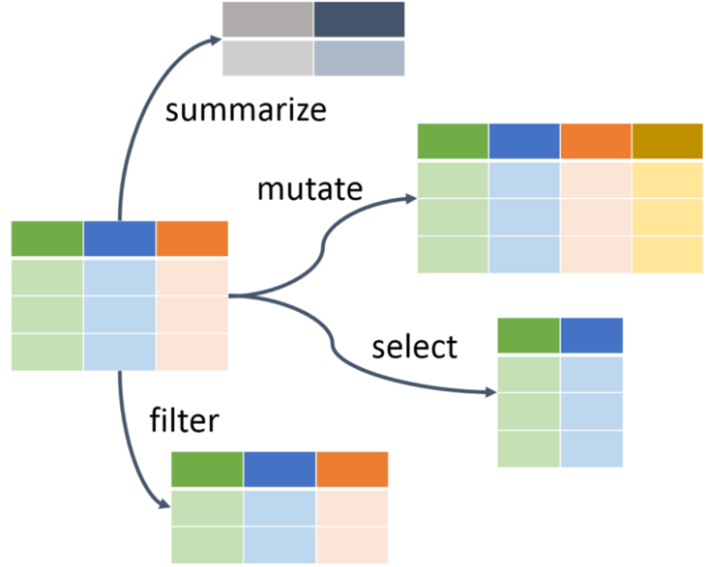
dplyr
A consistent set of functions to tackle the most common data manipulation challenges:
mutate(): adds new columns or modifies existing ones
select(): select variables based on their names
filter(): select rows based on conditions
summarise(): reduces multiple values down to a single summary
arrange(): changes the ordering of the rows
These functions are very often combined with the group_by() function
group_by &
summarize
mutate
select
filter

Slide 7
Pipes
“powerful tool for clearly expressing a sequence of multiple operations”
Automatically loaded within the tidyverse packages
The most known (%>%) comes from the magrittr package
Although extremely useful, avoid them when you combine different data frames or when the operations include too many steps
e.g. this:
data <- select(data, columnA, columnB)
data <- mutate(data, columnC = “NewCol”)
can be transformed into this:
data <- data %>% select(columnA, columnB) %>% mutate(columnC=“NewCol”)

Slide 8
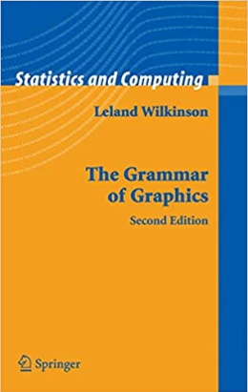
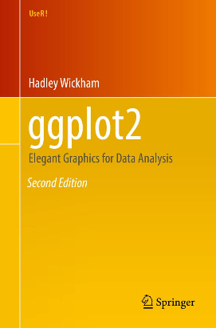
Part IIIb
Visualization with ggplot2

Slide 9
ggplot2
A package to create statistical graphics using a deep underlying grammar
A statistical graphic is the mapping from data to aesthetic attributes (shape, size, colour) of geometric elements (points, lines, bars). It might contain statistical transformations of the data and is drawn on a specific coordinate system [ggplot2: elegant graphics for data analysis, 2nd ed., Hadley Wickam]
Grammar of graphics: every graph is comprised out of specific components
Data and aesthetic mappings
Layers (geometric element & statistical transformations)
Scales, coordinates, faceting (the same plot with different subsets od the original data), themes
No limit on the graphics you can create
https://www.r-graph-gallery.com/ggplot2-package.html

Slide 10
Structure of ggplot2
Theme
Everything starts with a call to ggplot(), specifying the data that will be used and aesthetic elements, passed with aes() function:
ggplot(df, aes(x, y, other aesthetics))
More elements, such as layers, scales, coords and facets, can be added to the basis created by ggplot using “+”
ggplot(df, aes(x, y, other aesthetics)) +
geom_bar() +
ggtitle() +
ggtheme()
Finally, ggsave() can be used to extract the created plots
Coordinates
Statistics
Facets
Geometrics
Aesthetics
Data

Slide 11
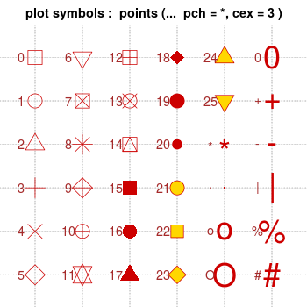
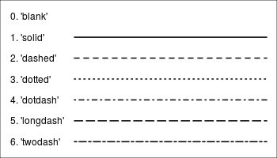
Aesthetics
Describes how variables in the data are mapped to visual properties (aesthetics) of geometric elements
Most common arguments:
x and y
colour, fill and alpha
group, order
linetype, size and shape
xmin, xmax, ymin, ymax, xend, and yend
We can define aesthetics either in ggplot’s main call [inside ggplot()] or in individual layers – pay attention not to override previous mappings [inside geom_*()]
http://www.cookbook-r.com/Graphs/Shapes_and_line_types/

Slide 12
Geometric elements *most common*
geom_points() creates a scatterplot
geom_line() creates a line plot
geom_bar() creates a barplot
Its default setting is to produce the count (stat=‘count’)
If we want the raw data, we need to set stat=‘identity’
geom_boxplot() and geom_violin() create boxplots and violin plots
geom_histogram()
geom_freqply() creates a histogram with frequencies instead of counts
geom_text() adds labels to x or y

Slide 13
Choosing a plot
Variables | Plot
1 discrete | Bar plot
1 continuous | Histogram Freqpoly Density
2 continuous | Scatterplot Text labels Density2D
1 continuous + 1 discrete | Bar plot Box plot Violin plot

Slide 14
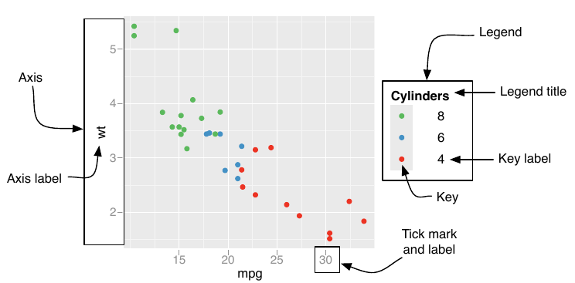
Scales
Scales can be either continuous or discrete
Axes and legends have the same 3 arguments:
name: the title of the legend and the label of the axis
breaks: the key for legends and the ticks for axes
labels: the key label for legends and the tick label for axes
In addition, we can modify:
The labels and legends of the axes or the main plot:
labs(), xlab(), ylab()
ggtitle()
The limits of the axes: lims(), xlim(),ylim()

Slide 15
Colour
Each colour can be characterized as the combination of Red-Green-Blue colours
Mapping values to colours:
Continuous variables:
scale_colour_gradient() and scale_fill_gradient(): 2-colour gradient
scale_colour_gradient2() and scale_fill_gradient2(): 3-colour gradient
scale_colour_gradientn() and scale_fill_gradientn(): n-colour gradient
scale_colour_distiller() and scale_fill_distiller(): apply the Color-Brewer colour scales
Discrete variables:
scale_colour_hue() and scale_fill_hue(): change the hue
scale_colour_brewer() and scale_fill_brewer(): apply ColorBrewer palettes
scale_colour_grey() and scale_fill_grey(): use only grays
scale_colour_manual() and scale_fill_manual(): custom picked colours

Slide 16
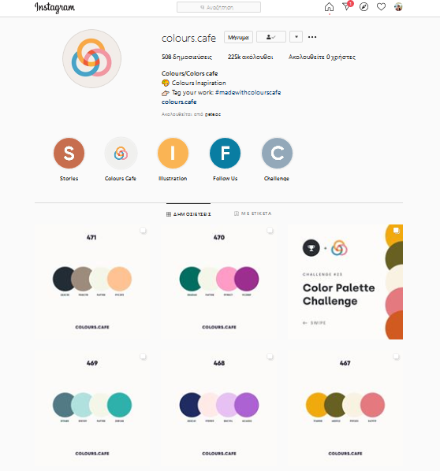
Colour
You can manual select the colours, use an existing palette or get inspired
@colours.cafe

Slide 17
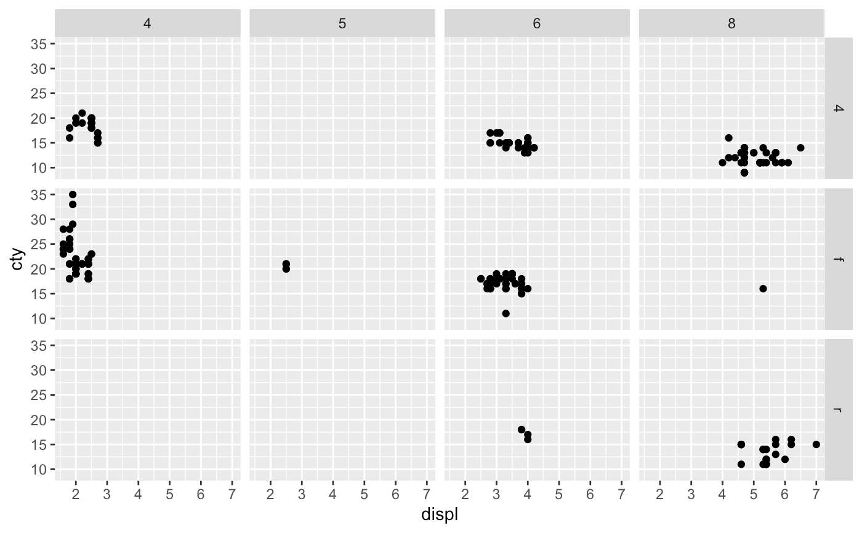
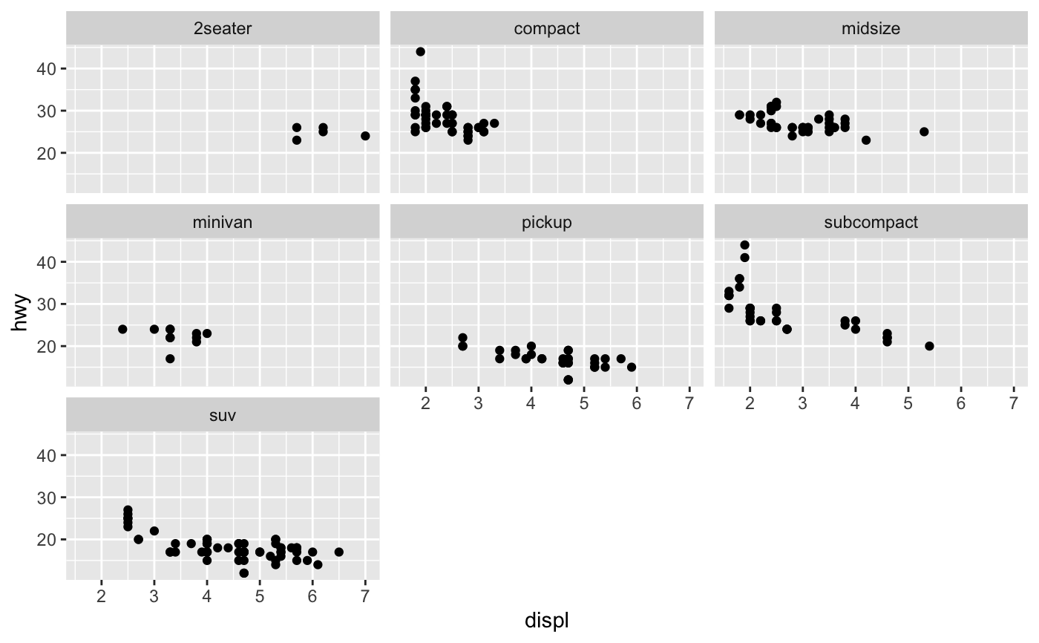
Faceting
Faceting: plot your data with regards to one or more discrete variables
facet_grid(): if we have 2 or more discrete variables
facet_wrap(): if we have 1 discrete variable with many level

Slide 18

Facet grid
mpg dataset: Fuel economy data from 1999 to 2008 for 38 popular models of cars
Scatter plot
cty: city miles per gallon
drv: the type of drive train, where f = front-wheel drive, r = rear wheel drive, 4 = 4wd
displ: engine displacement, in litres
cyl: number of cylinders

Slide 19
Facet wrap
mpg dataset: Fuel economy data from 1999 to 2008 for 38 popular models of cars
Scatter plot
hwy: highway miles per gallon
displ: engine displacement, in litres
class: "type" of car

Slide 20
Coordinates, Themes and saving the plots
Coordinates: coord_*()
Default is cartesian
Themes: theme_*()
You can choose between a variety of pre-defined themes, or create a custom-defined theme that suits your aesthetic
Save the plots you created with:
ggsave(filename, plot, device, scale = 1, width,
height , units = c("in", "cm", "mm"), dpi = 300, ...)

Slide 22
Resources
https://www.tidyverse.org/
https://r4ds.had.co.nz/
https://cran.r-project.org/web/packages/dplyr/vignettes/dplyr.html
https://blog.rstudio.com/2014/01/17/introducing-dplyr/
https://genomicsclass.github.io/book/pages/dplyr_tutorial.html
https://cran.r-project.org/web/packages/dplyr/vignettes/base.html
https://ggplot2.tidyverse.org/
ggplot2: Elegant Graphics for Data Analysis, 2nd Ed., by Hadley Wickham
http://r-statistics.co/Complete-Ggplot2-Tutorial-Part1-With-R-Code.html
https://www.publichealth.columbia.edu/sites/default/files/media/fdawg_ggplot2.html
http://www.sthda.com/english/wiki/be-awesome-in-ggplot2-a-practical-guide-to-be-highly-effective-r-software-and-data-visualization
http://www.cookbook-r.com/Graphs/Colors_(ggplot2)/
http://www.sthda.com/english/wiki/ggplot2-essentials
https://cran.r-project.org/web/packages/viridis/vignettes/intro-to-viridis.html

